Slide 1
Testing atmospheric models to correct protoplanetary disk spectra
Madison Walder
Dr. Andrea Banzatti, Lunar Planetary Lab
Arizona/NASA Space Grant Statewide Symposium
April 2019

Slide 2
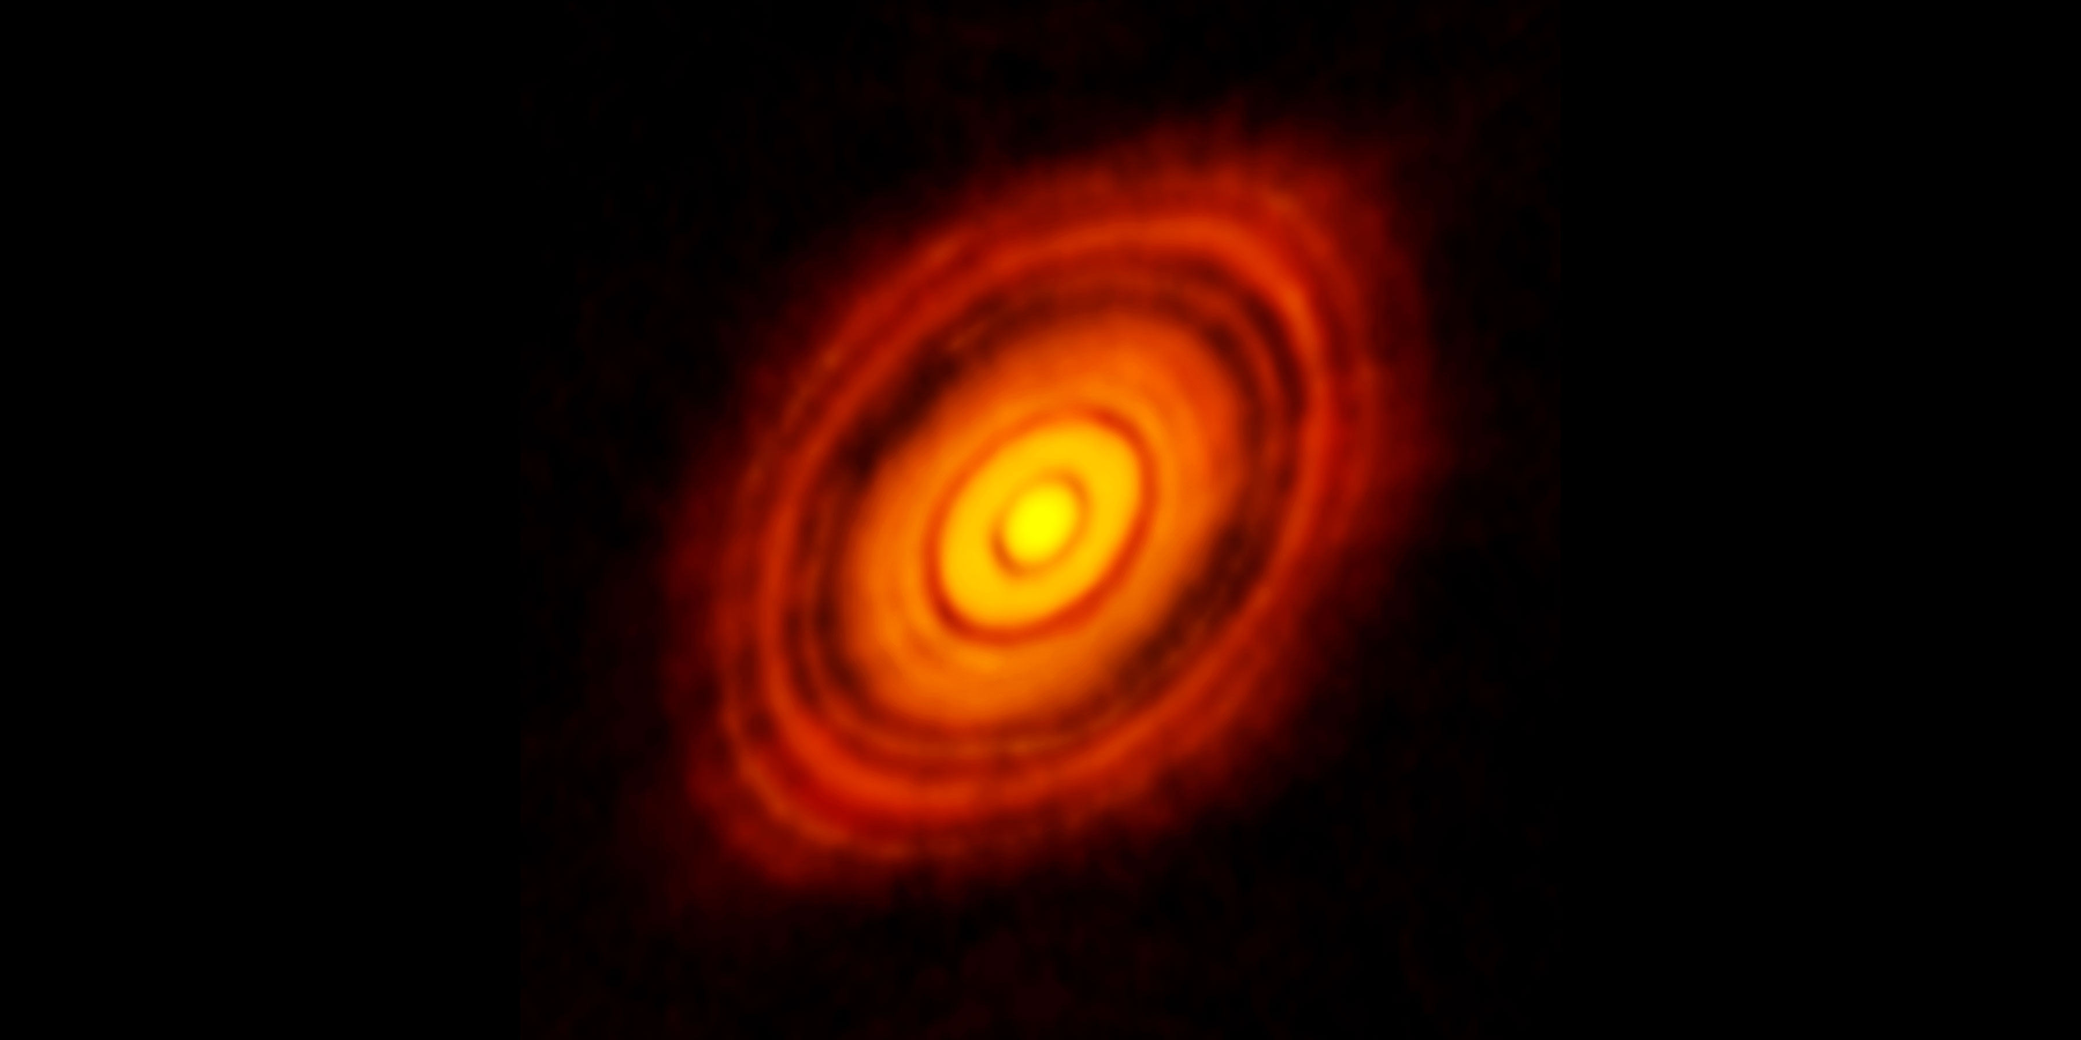
Background
ALMA image of a protoplanetary disk
We want to observe protoplanetary disks in the infrared, why?
5 au
Notes:
Because it probes the right temperature for where the terrestrial planets are found, the hottest part of the disk.
5au = region where exoplanets are found

Slide 3
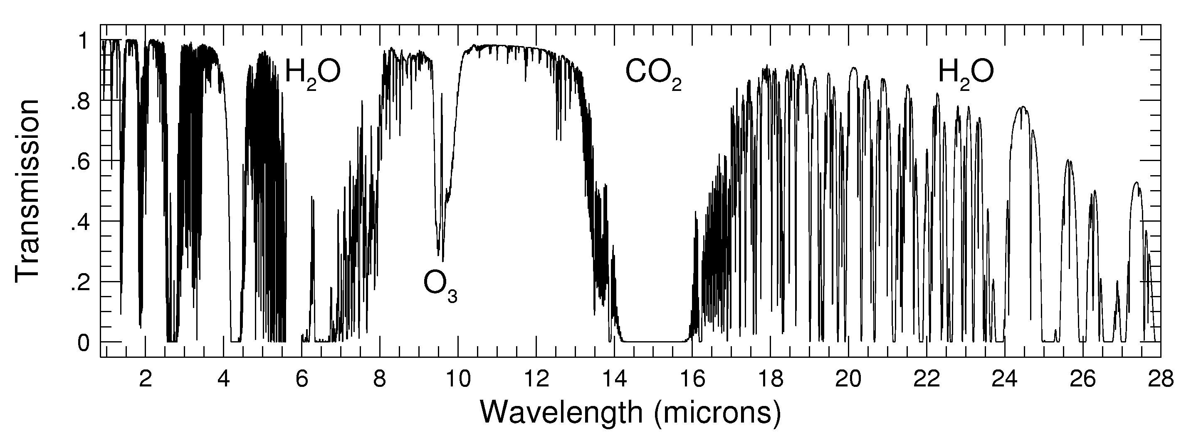
Background
So, what’s the problem?
  Earth’s atmosphere!
(credit: ohio-state.edu)
Notes:
We are trying to observe celestial objects in the near infrared, but most of the infrared spectrum is absorbed by the Earth’s atmosphere.
We observe around 12 microns because transmission is highest
How do we combat this problem?

Slide 4
Background
What is a telluric “standard”?
  a bright object that is “featureless” in the wavelengths of interest, observed at similar airmass as a science target in order to correct spectra for absorption lines produced by Earth’s atmosphere
Vega
511 Davida
(credit: wsmcr.org)
(credit: Stephen Rahn, flickr.com)
Notes:
Image on left is 511 Davida, on right Vega
“featureless” = has no strong absorption/emission lines
Must be featureless at wavelengths we are observing

Slide 5
Objective
But observing telluric standards is expensive…
  ~20% of the time is spent on standards (5 nights of 24!)
  A community effort (ESO-VLT, NASA-IRTF, ..) to make observations more efficient
What is Molecfit and why are we using it?
  provided by ESO for the Very Large Telescope
  A model of Earth’s atmosphere
  Correct IR spectra without observing a telluric standard
  We are the first to apply it to VISIR (The VLT Imager and Spectrometer for mid-InfraRed) after a recent upgrade of the instrument.
The Very Large Telescope (credit: pbs.org)
Notes:
But observing telluric standards
Molecfit is a software provided by the European Southern Observatory to model these atmospheric absorption lines by fitting the observed spectra, without requiring the observation of a telluric standard
We are the first to explore Molecfit as applied to high-resolution infrared spectra of protoplanetary disks from VISIR, a newly upgraded spectrograph on the Very Large Telescope.
We compare the telluric correction obtained in this way with that of using a telluric standard, working towards the ultimate goal of making observations more efficient by reducing the amount of time dedicated to observing telluric standards.

Slide 6
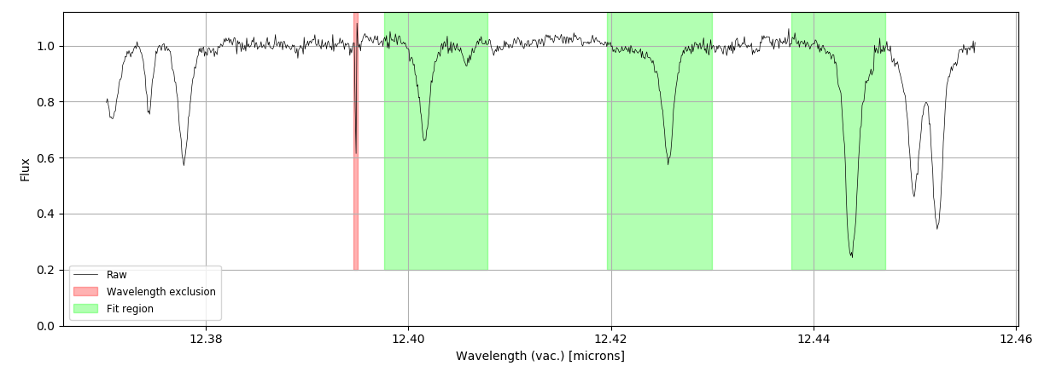
Method
Notes:
Describe how molecfit works and how we applied it to protoplanetary disk spectra
First select regions of spectra to be fitted, distinguish features of regions

Slide 7
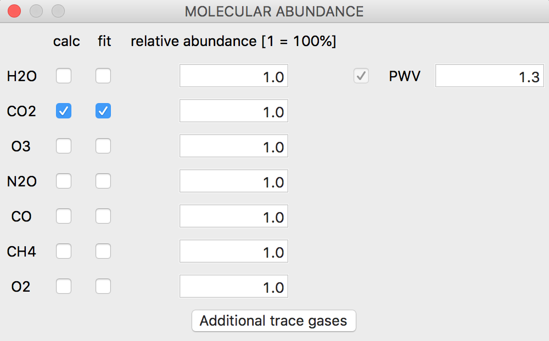
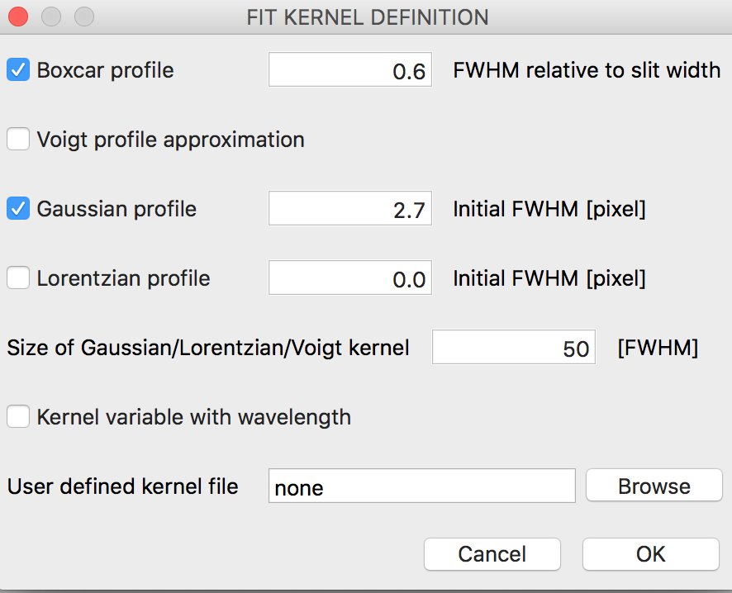
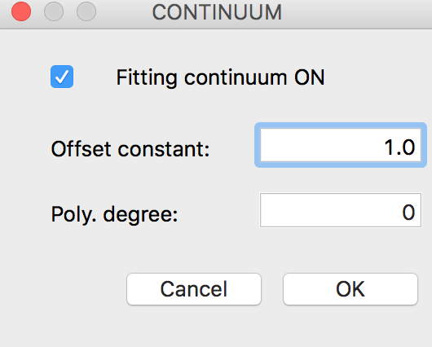
Method
Select molecules to be fitted
Input polynomial degree of wavelength correction
Select resolution fitting profile and FWHM values
Input polynomial degree of continuum
Fit!

Slide 8
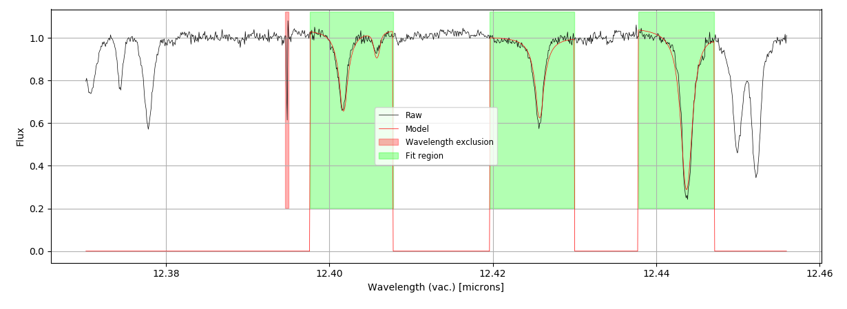
Result
Notes:
Here’s what the fit looks like!

Slide 9
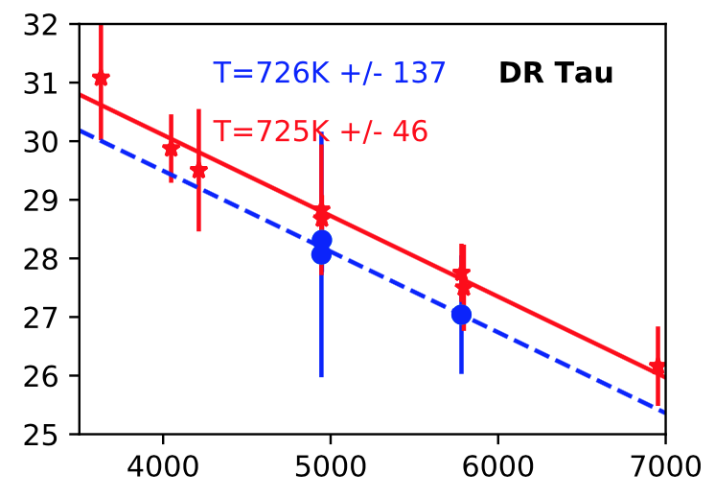
The Goal: measure H2O emission
After correction, we can use the spectra to determine the temperature and column density of water in planet-forming regions!
Example of one of our spectra:
(credit: Salyk et al. 2019)
Notes:
Put in figure from Salyk
Final goal: measuring water emission

Slide 10
Summary & Conclusions
We observe protoplanetary disks in the infrared to obtain spectra of molecules in their planet-forming regions
But the Earth’s atmosphere absorbs their emissions at those wavelengths!
So telluric standards are typically observed to correct for Earth’s absorption
But observing telluric standards is expensive (in terms of observing time)!
A community effort is to use atmospheric models instead (like Molecfit)
We test Molecfit on new VISIR spectra to contribute to the effort of:
  Reducing the amount of time dedicated to observing telluric standards
  Making future infrared-spectroscopy surveys more efficient (especially for the next generation of large telescopes: GMT, ELT, TMT)
Notes:
Focus on effort to reduce time dedicated to observing telluric standards, and how we’re contributing to making observing infrared-spectroscopy more efficient
GMT, TMT each will have their own high resolution infrared spectrographs

Slide 11
Acknowledgements
Dr. Andrea Banzatii
Arizona Space Grant Consortium
NASA – IRTF Grant

